Slide 1
Real World Applications of Various Machine Learning Models
ENGR 96A: Machine Learning

Slide 2
Fully Connected Layers
Mostly used connected to other layers
Good for slightly changing a different neural network to work for a new purpose
Most basic layer
Good at adding general complexity

Slide 3
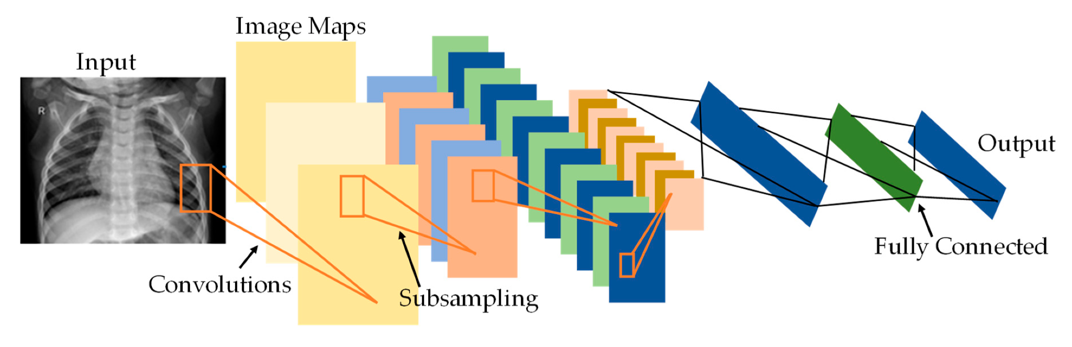
Convolutional Neural Networks
Mostly used for computer vision tasks
Good for tasks where space is important
Autonomous vehicle object detection, medical image recognition, handwriting detection

Slide 4

Generative Adversarial Network
Useful for when new data needs to be created
Two sub-models: Generator and Discriminator
Generator generates fake data and discriminator attempts to classify real from fake data
Common uses include image generation, 3D projections from 2D images, deepfakes

Slide 5
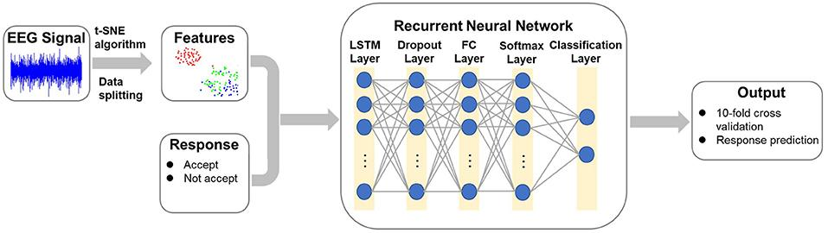
Recurrent Neural Network
Capable of receiving data over a series of time
Used for tasks where time is important
EEG data, speech-to-text, sentiment analysis

Slide 6
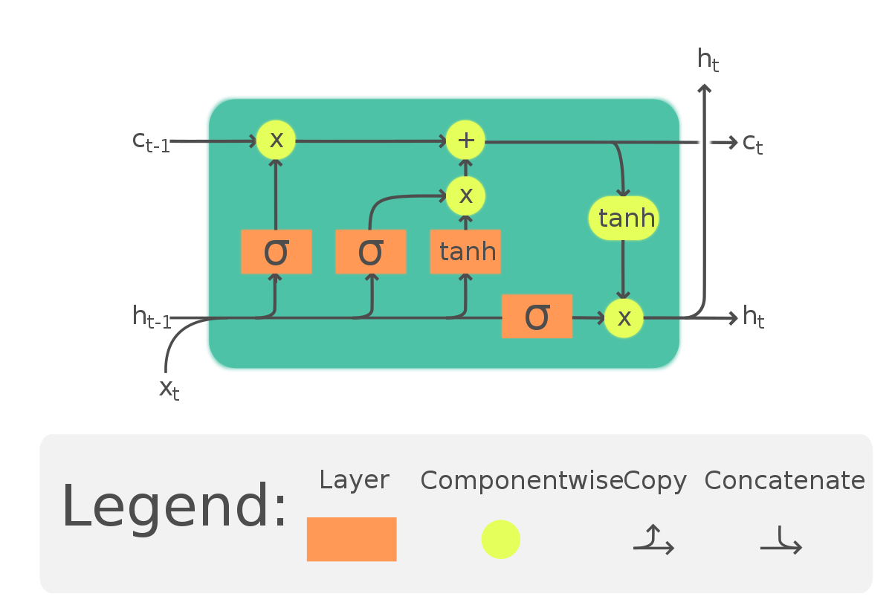
LSTM: Long Short-Term Memory
Problem with RNNs: exploding and vanishing gradients
Type of RNN that is regulated by gates
Useful for remembering data from far back in our sequence
Applications: sentiment analysis, language modeling, speech recognition
Memory cell:

Slide 7
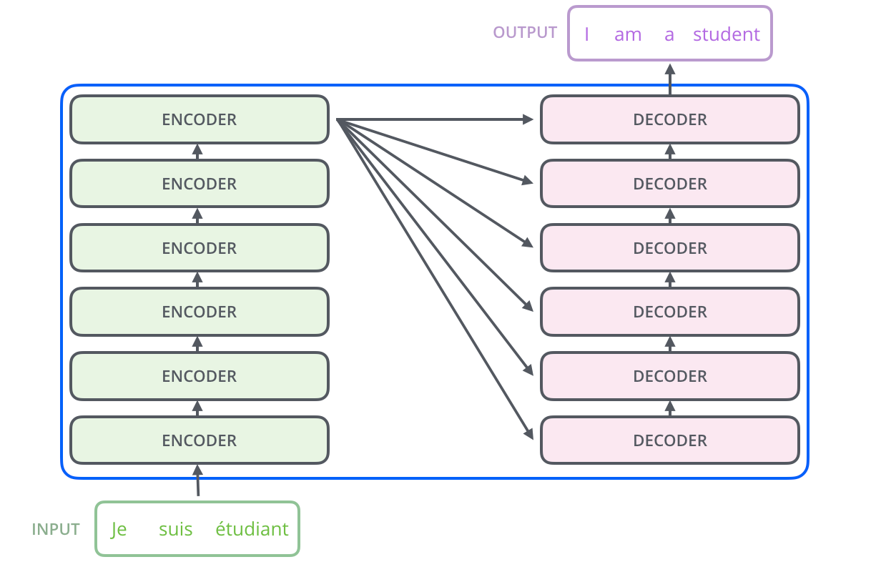
Transformers
Problem with RNNs/LSTMs: vanishing and exploding gradients and sequential input
Transformers solve this by using attention and parallelizing computation
Attention: mechanism that determines which words are most important to focus on
Applications: machine translation, text classification, image captioning

Slide 8
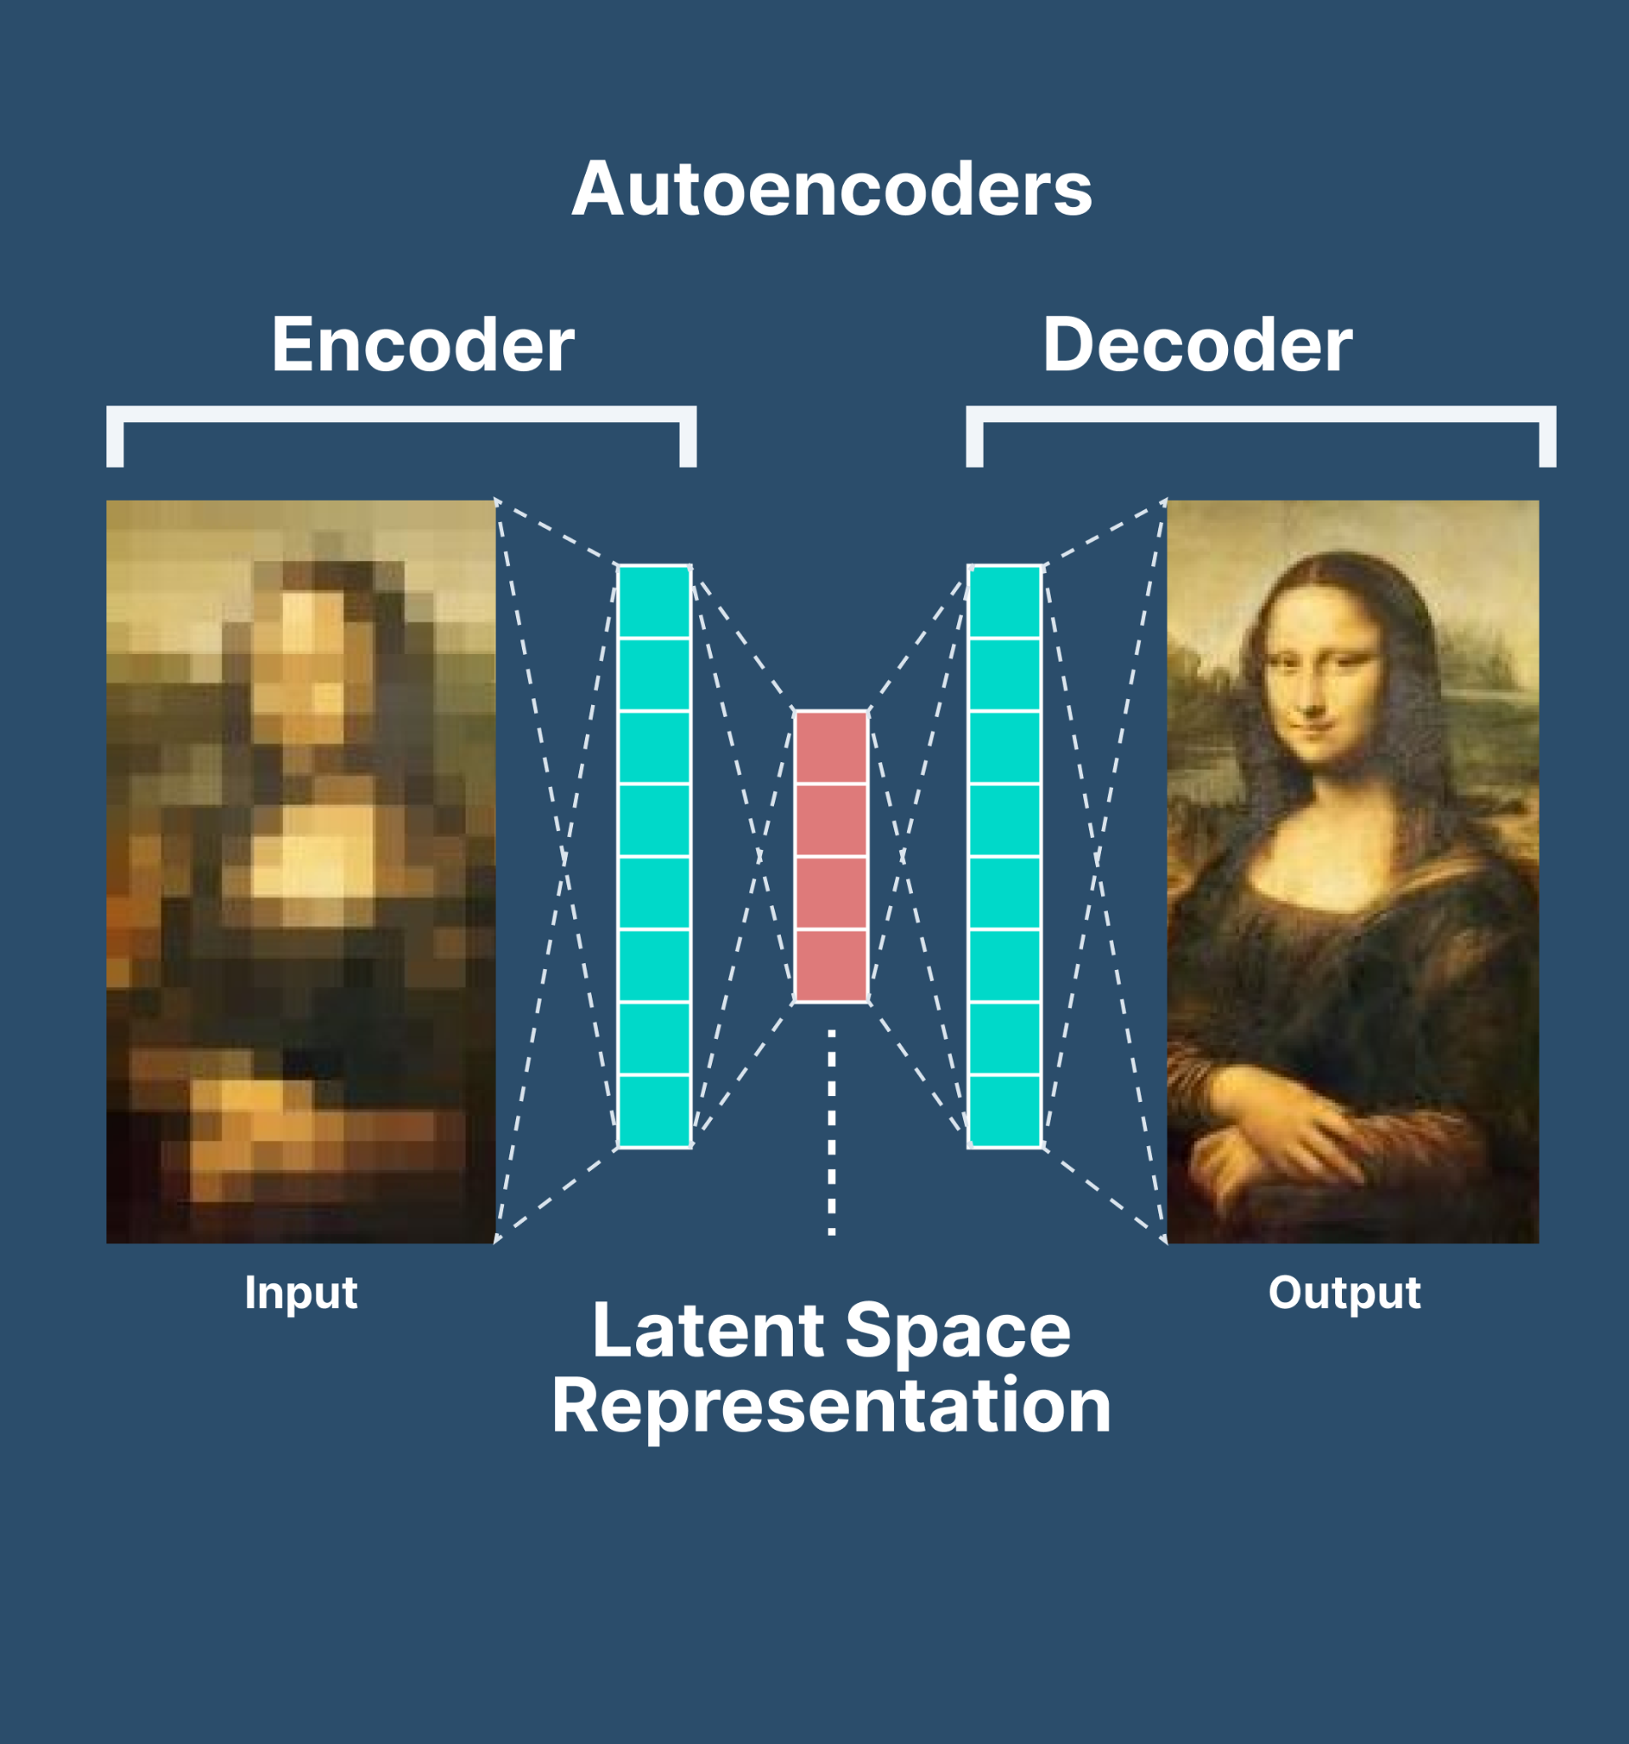
Autoencoders
Technique for lowering and increasing the dimensionality of an image
Mostly used for data processing
Cleaning up data for other neural networks, enhancing images, compression

Slide 9
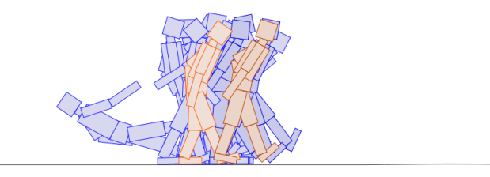
Evolutionary Algorithms
Useful for optimization problems
Create multiple models, test them, select the best one, repeat
Very general use
Chess bots, robot movement

Slide 10
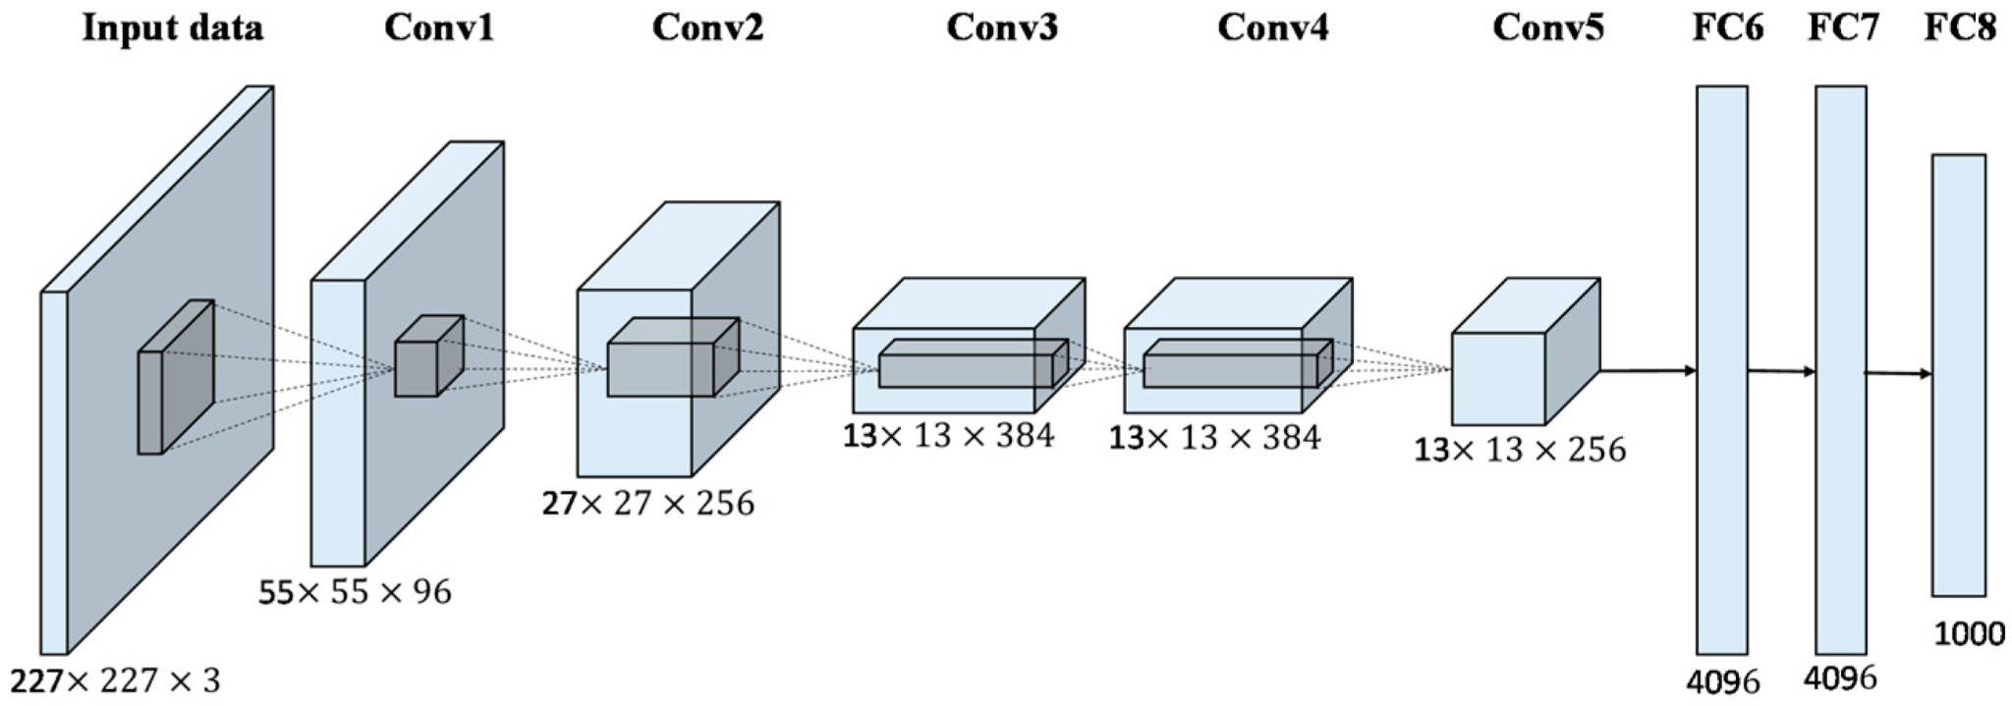
AlexNet

Slide 11
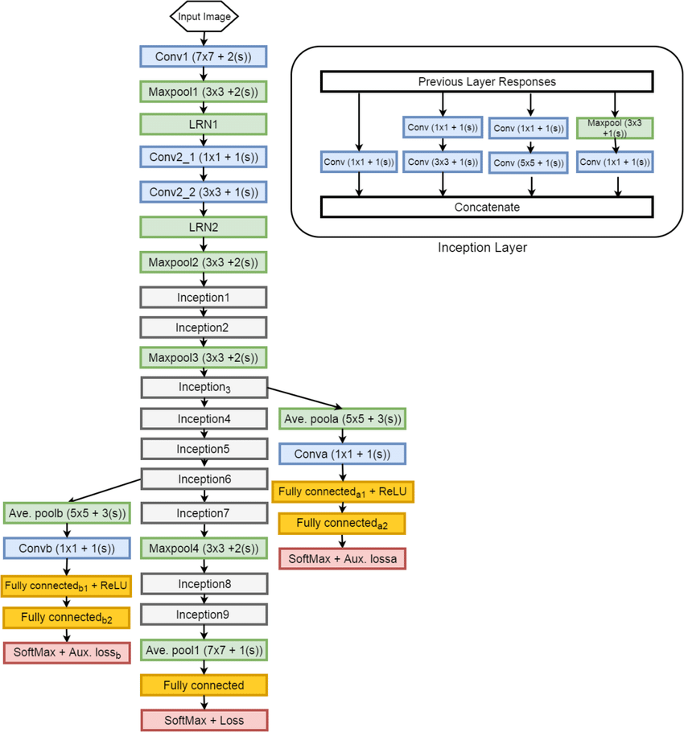
GoogleNet

Slide 12
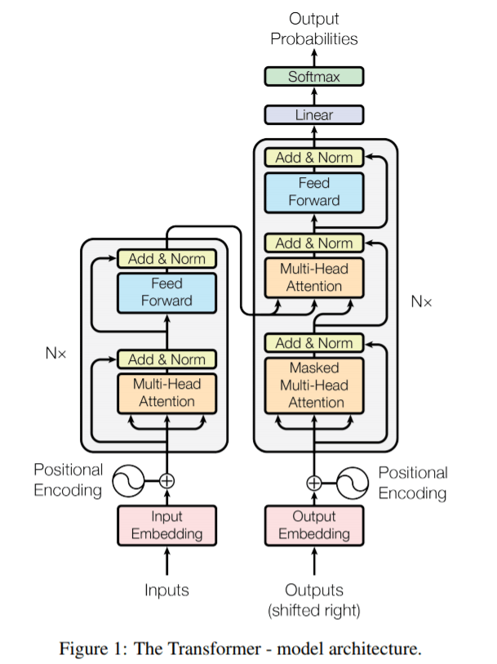
GPT-3
175 billion parameters
Trained on about 600 billion words
GPT-4: 100 trillion parameters

